Slide 1
Combining NLP and elasticsearch for building semantic search application

Slide 2

What is NLP
an area of computer science and artificial intelligence concerned with the interactions between computers and human (natural) languages, in particular how to program computers to process and analyze large amounts of natural language data.

Slide 3
Different Applications of NLP
Text Classification
Information Extraction
Machine Translation
Question Answering
Document Summarization
engineering.quora.com/Applications-of-NLP-at-Quora

Slide 4

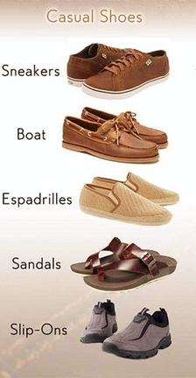
Problem Statement

Slide 5
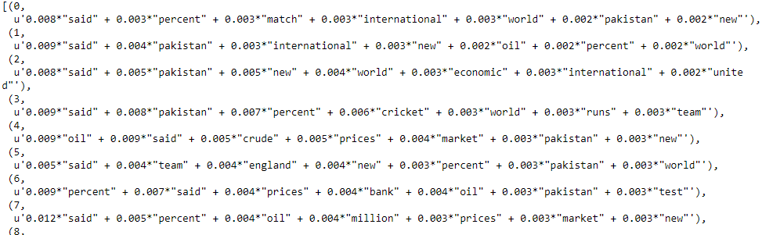
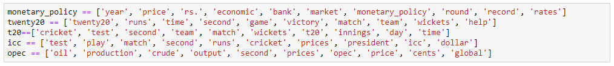
LDA Example
Source: https://www.kaggle.com/teemingyi/exploratory-analysis-on-news-heading/data

Slide 6
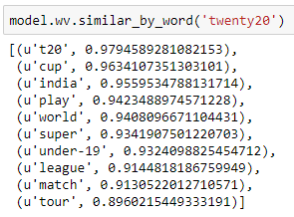
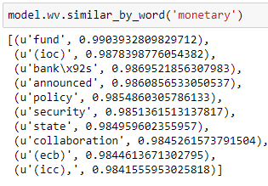
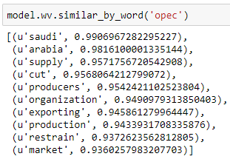
Word2vec Example

Slide 7
What is elasticsearch
Elasticsearch is a search engine based on Lucene. It provides a distributed, multitenant-capable full-text search engine with an HTTP web interface and schema-free JSON documents

Slide 8
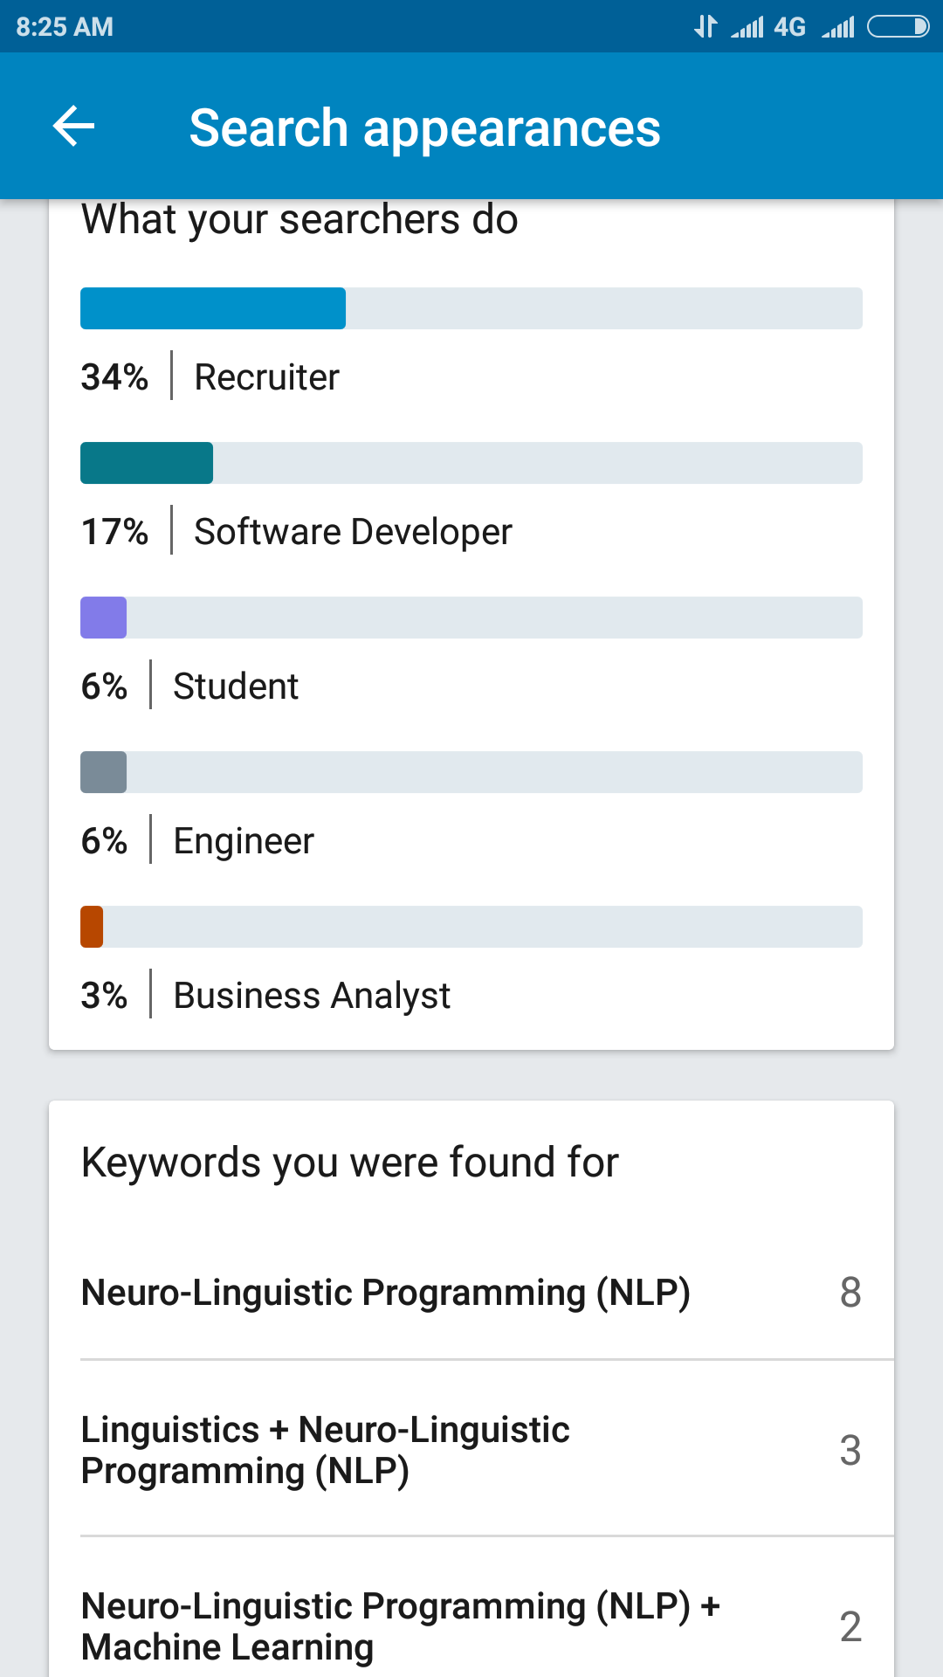
Combining NLP and Elasticsearch

Slide 9
Combining NLP and Elasticsearch
Simple Expansion
twenty20
twenty20, t20, under
-
19, cricket
t20
twenty20, t20, under
-
19, cricket
under
-
19
twenty20, t20, under
-
19, cricket
cricket
twenty20, t20, under
-
19, cricket

